Slide 1
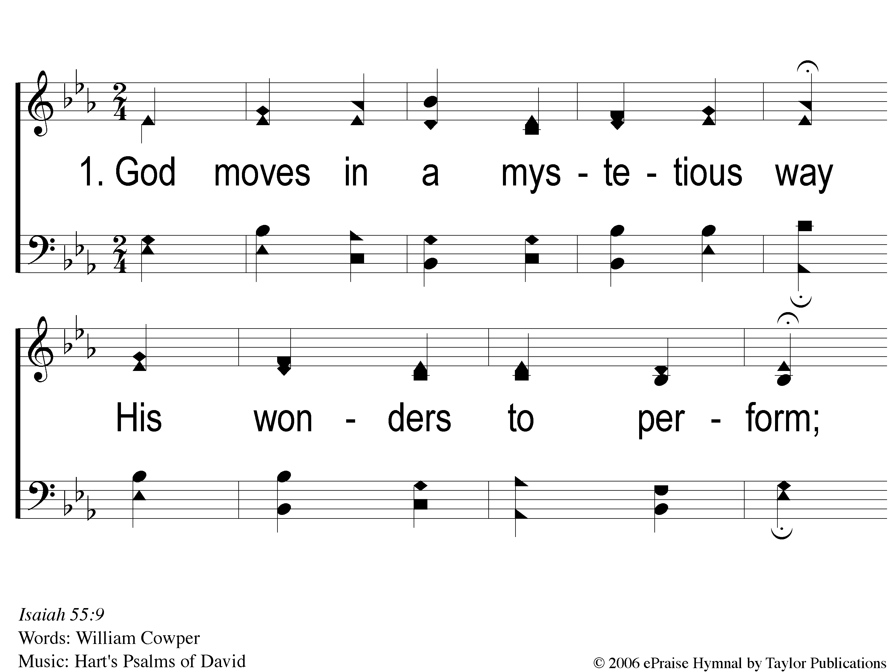
1-1 God Moves in a Mysterious Way
God Moves In A Mysterious Way
135

Slide 2
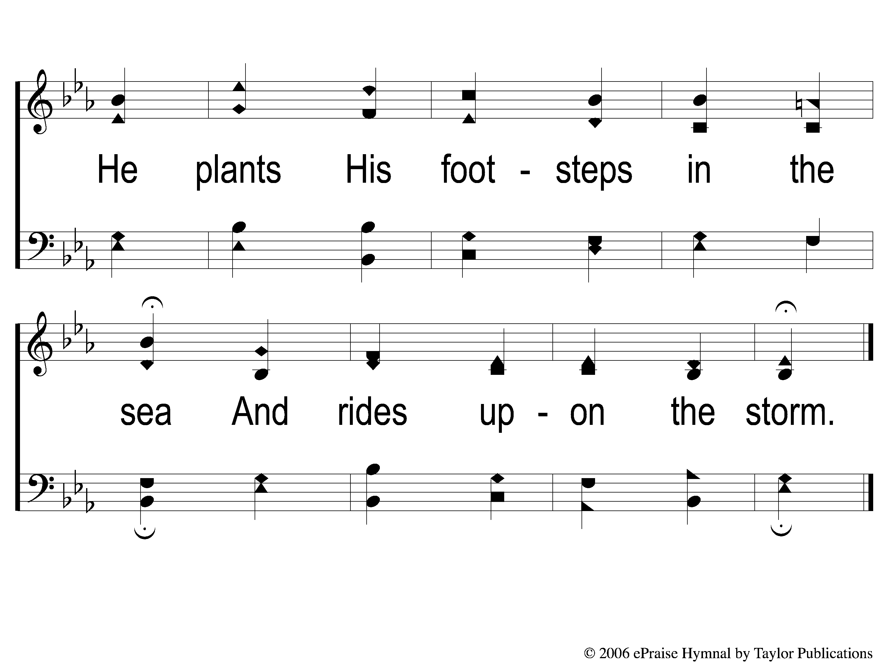
1-2 God Moves in a Mysterious Way
God Moves In A Mysterious Way
135

Slide 3
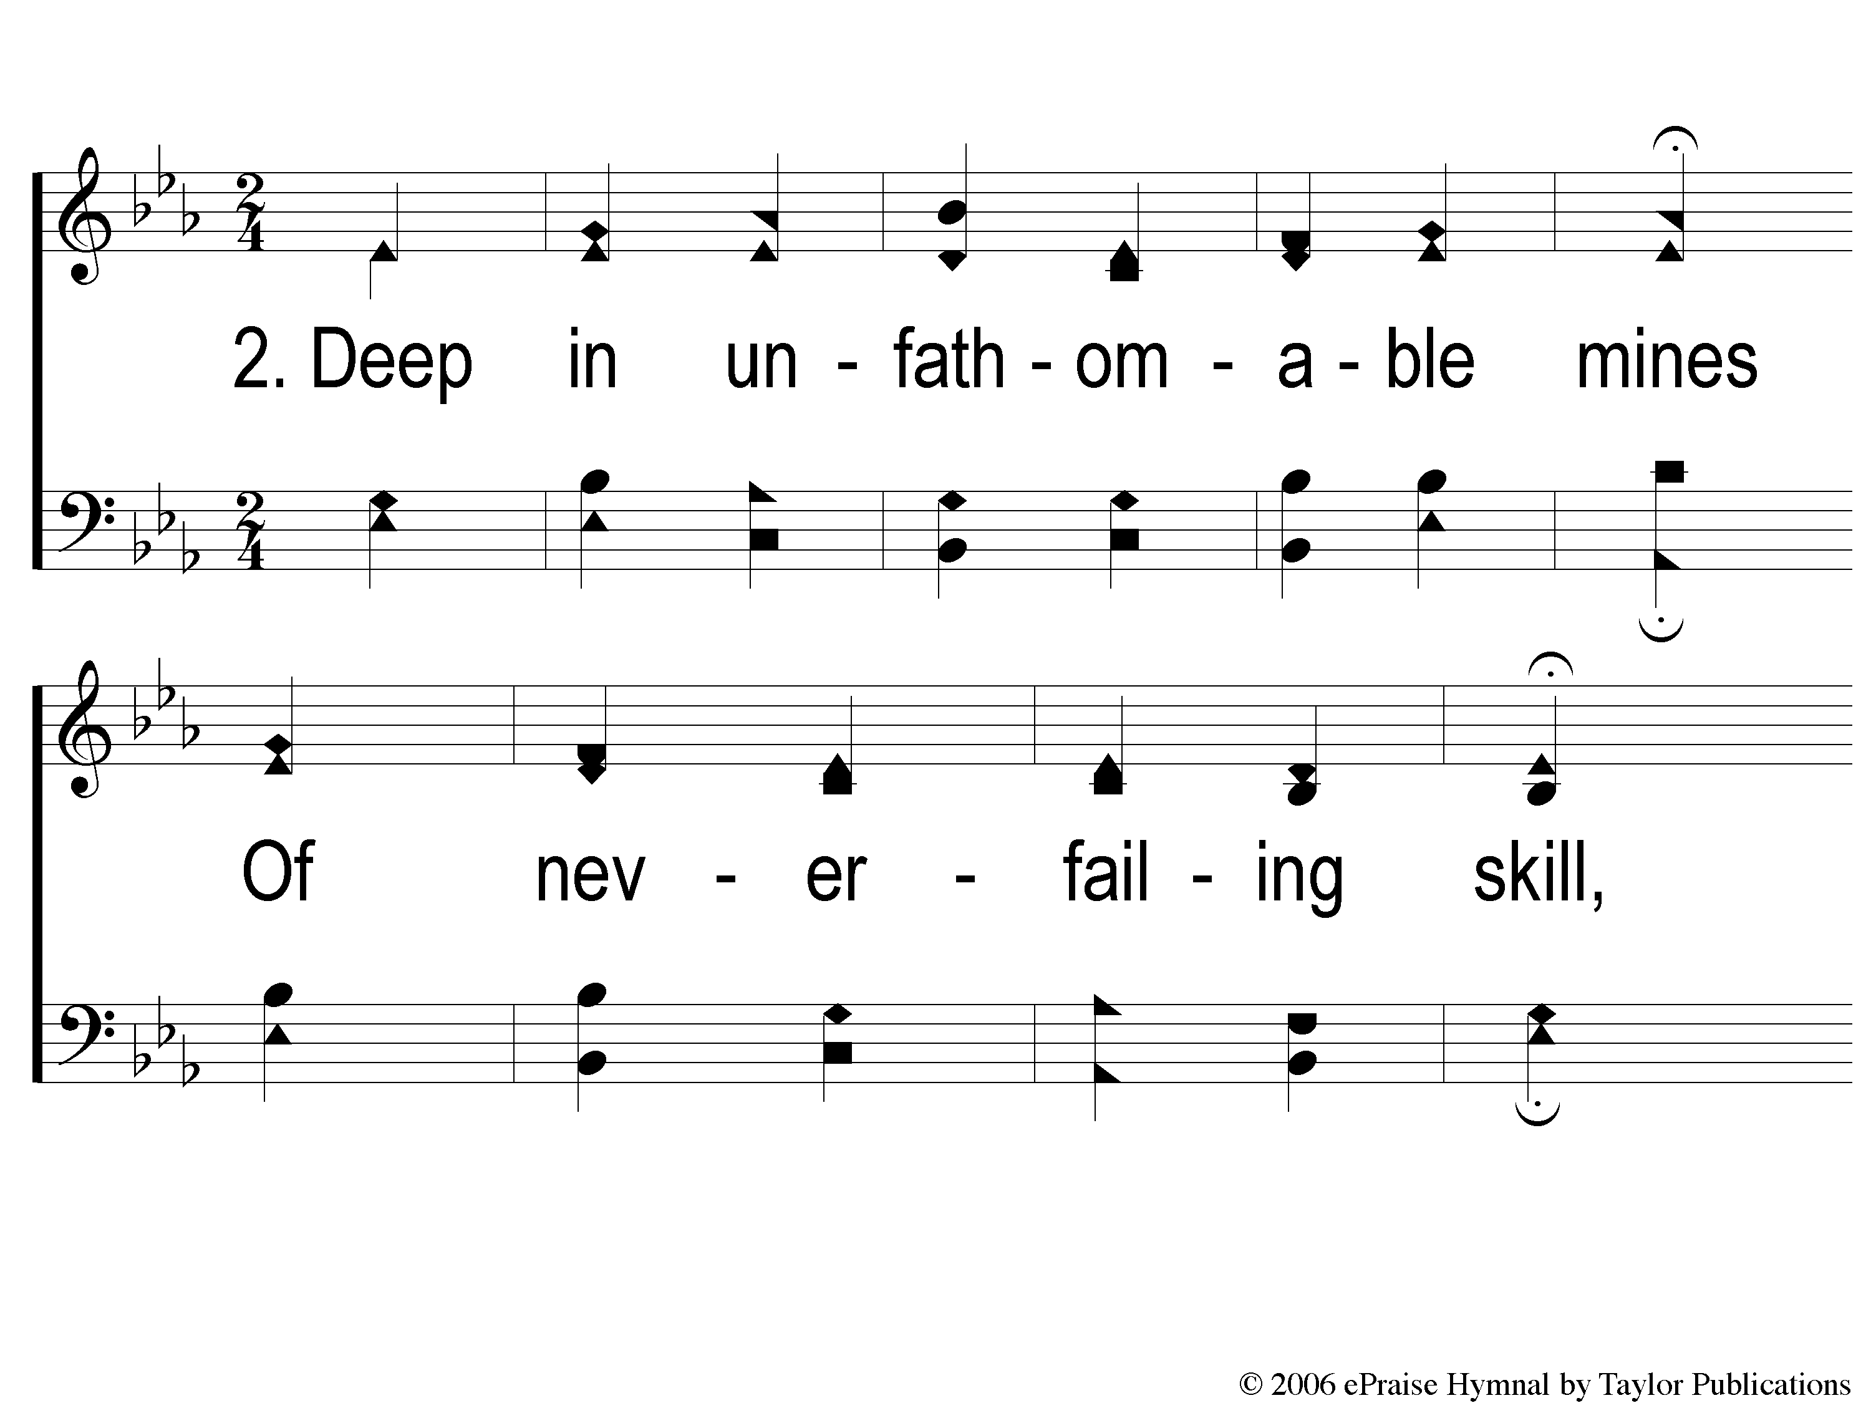
2-1 God Moves in a Mysterious Way
God Moves In A Mysterious Way
135

Slide 4
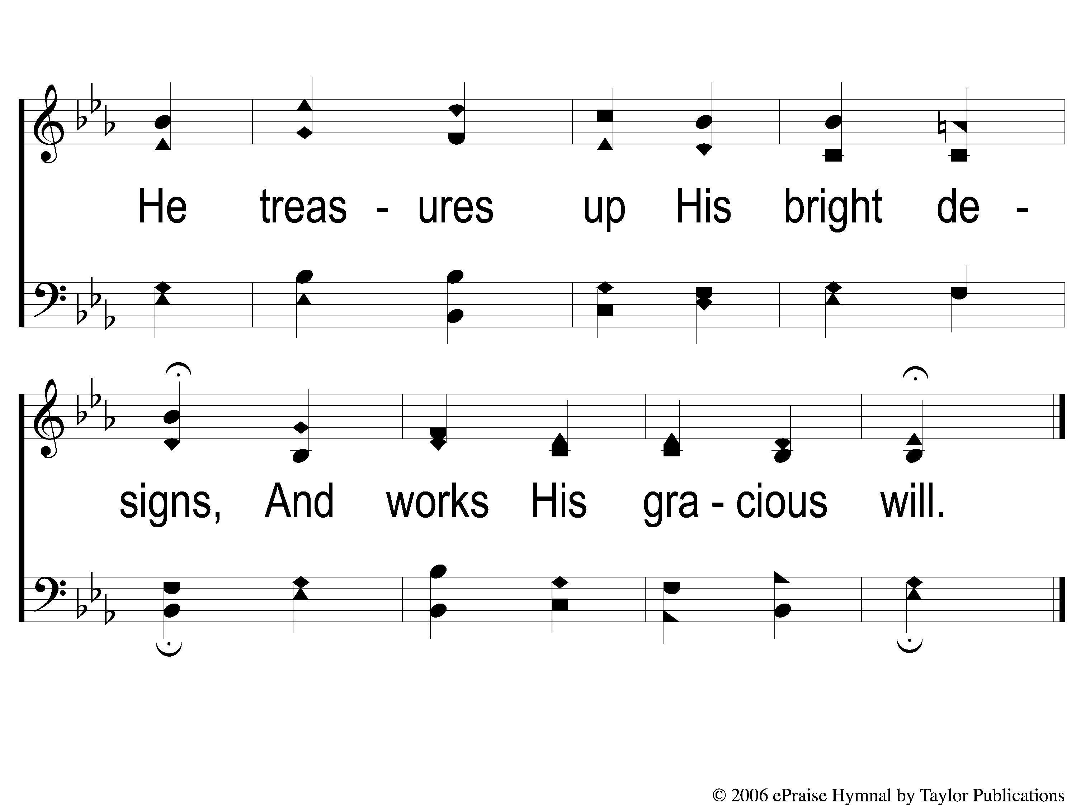
2-2 God Moves in a Mysterious Way
God Moves In A Mysterious Way
135

Slide 5
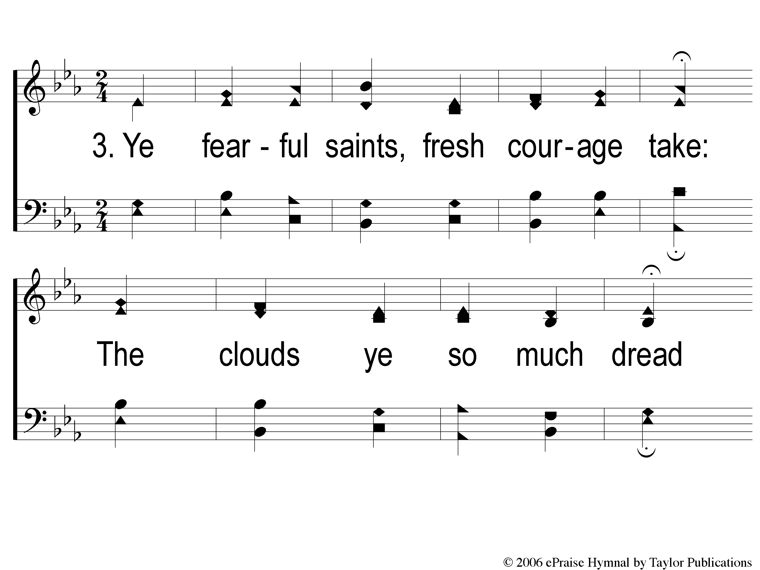
3-1 God Moves in a Mysterious Way
God Moves In A Mysterious Way
135

Slide 6
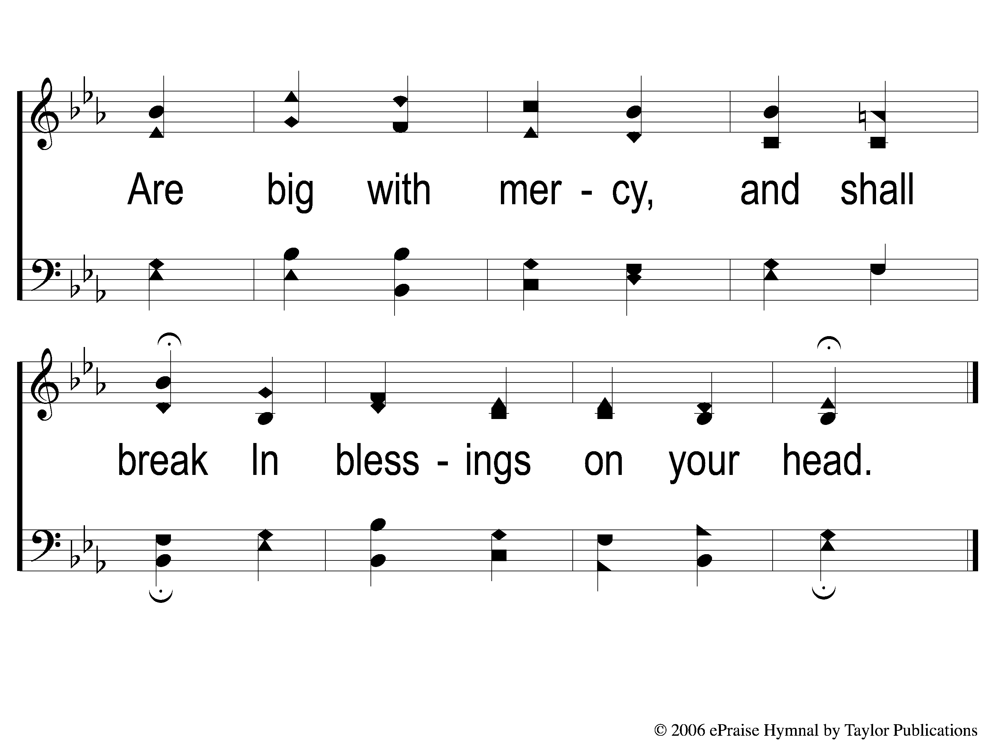
3-2 God Moves in a Mysterious Way
God Moves In A Mysterious Way
135

Slide 7
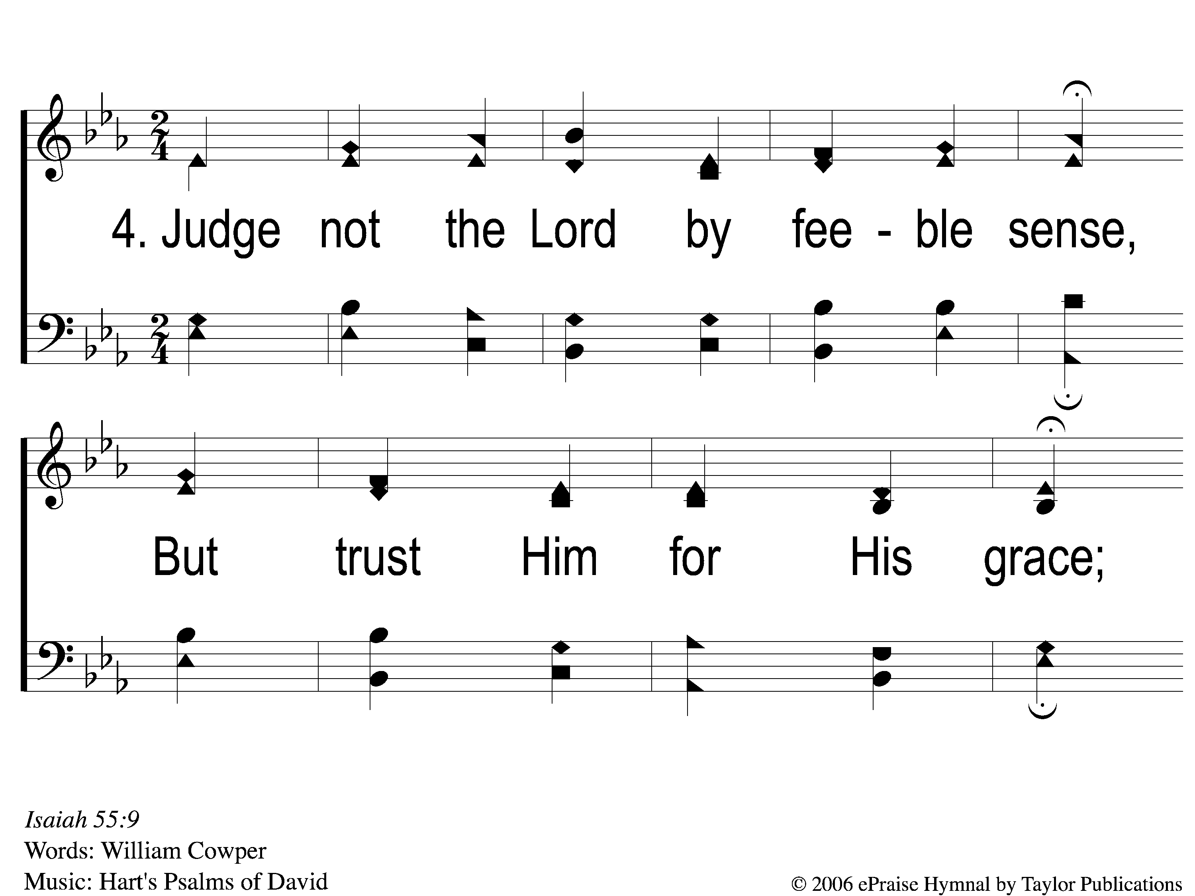
4-1 God Moves in a Mysterious Way
God Moves In A Mysterious Way
135

Slide 8
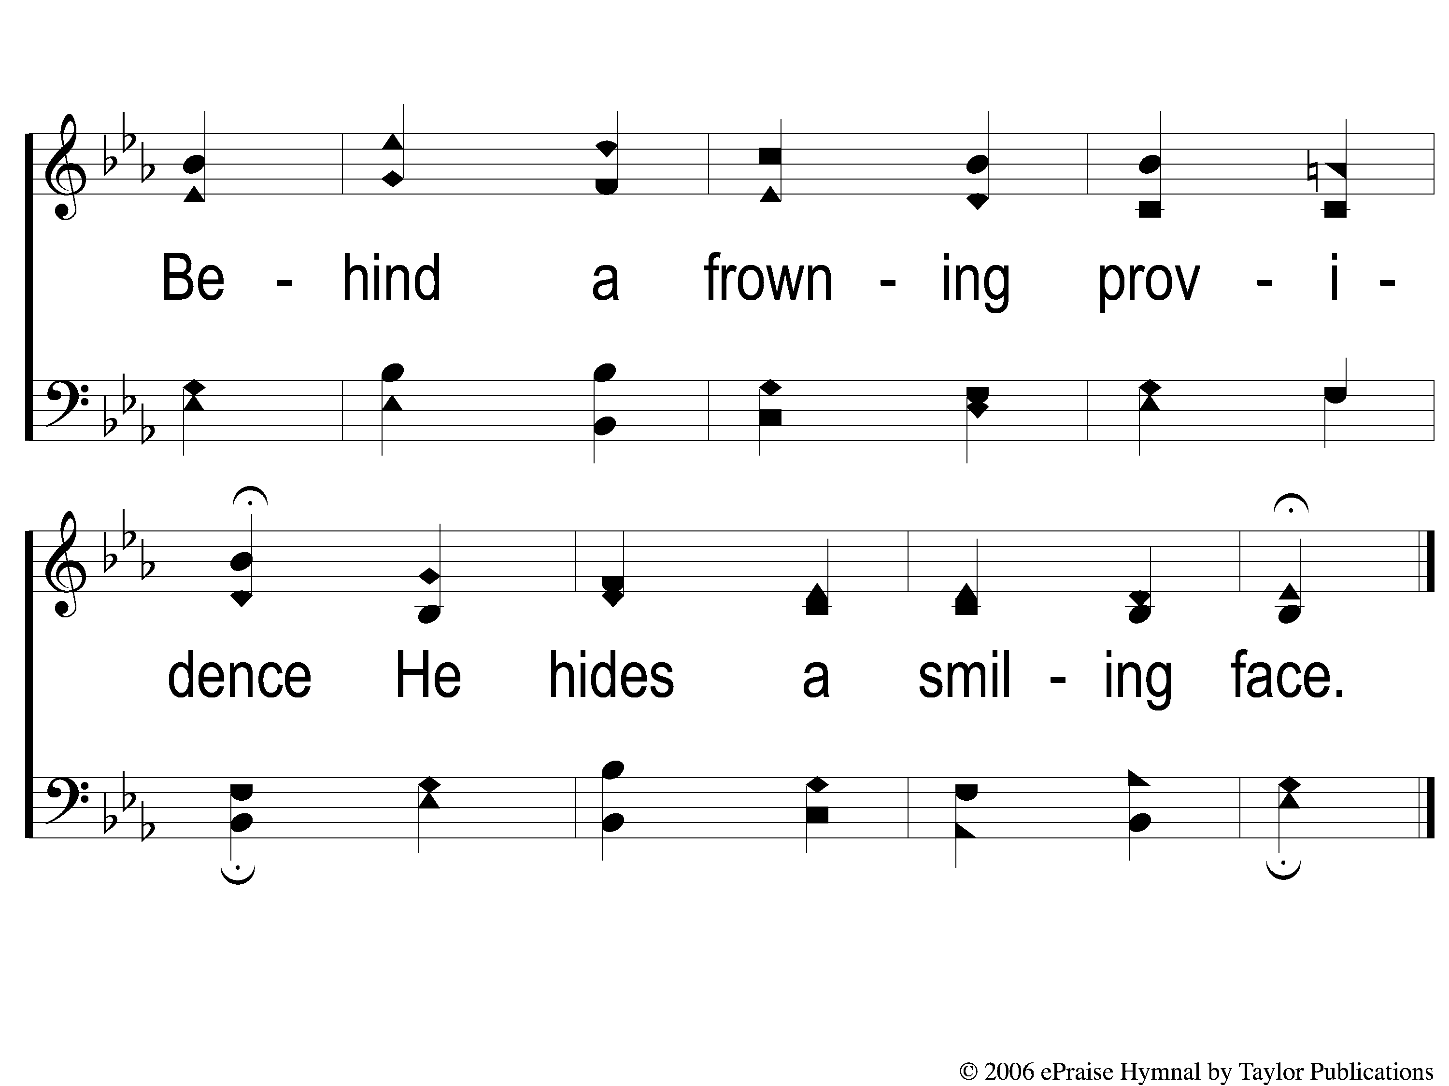
4-2 God Moves in a Mysterious Way
God Moves In A Mysterious Way
135

Slide 9
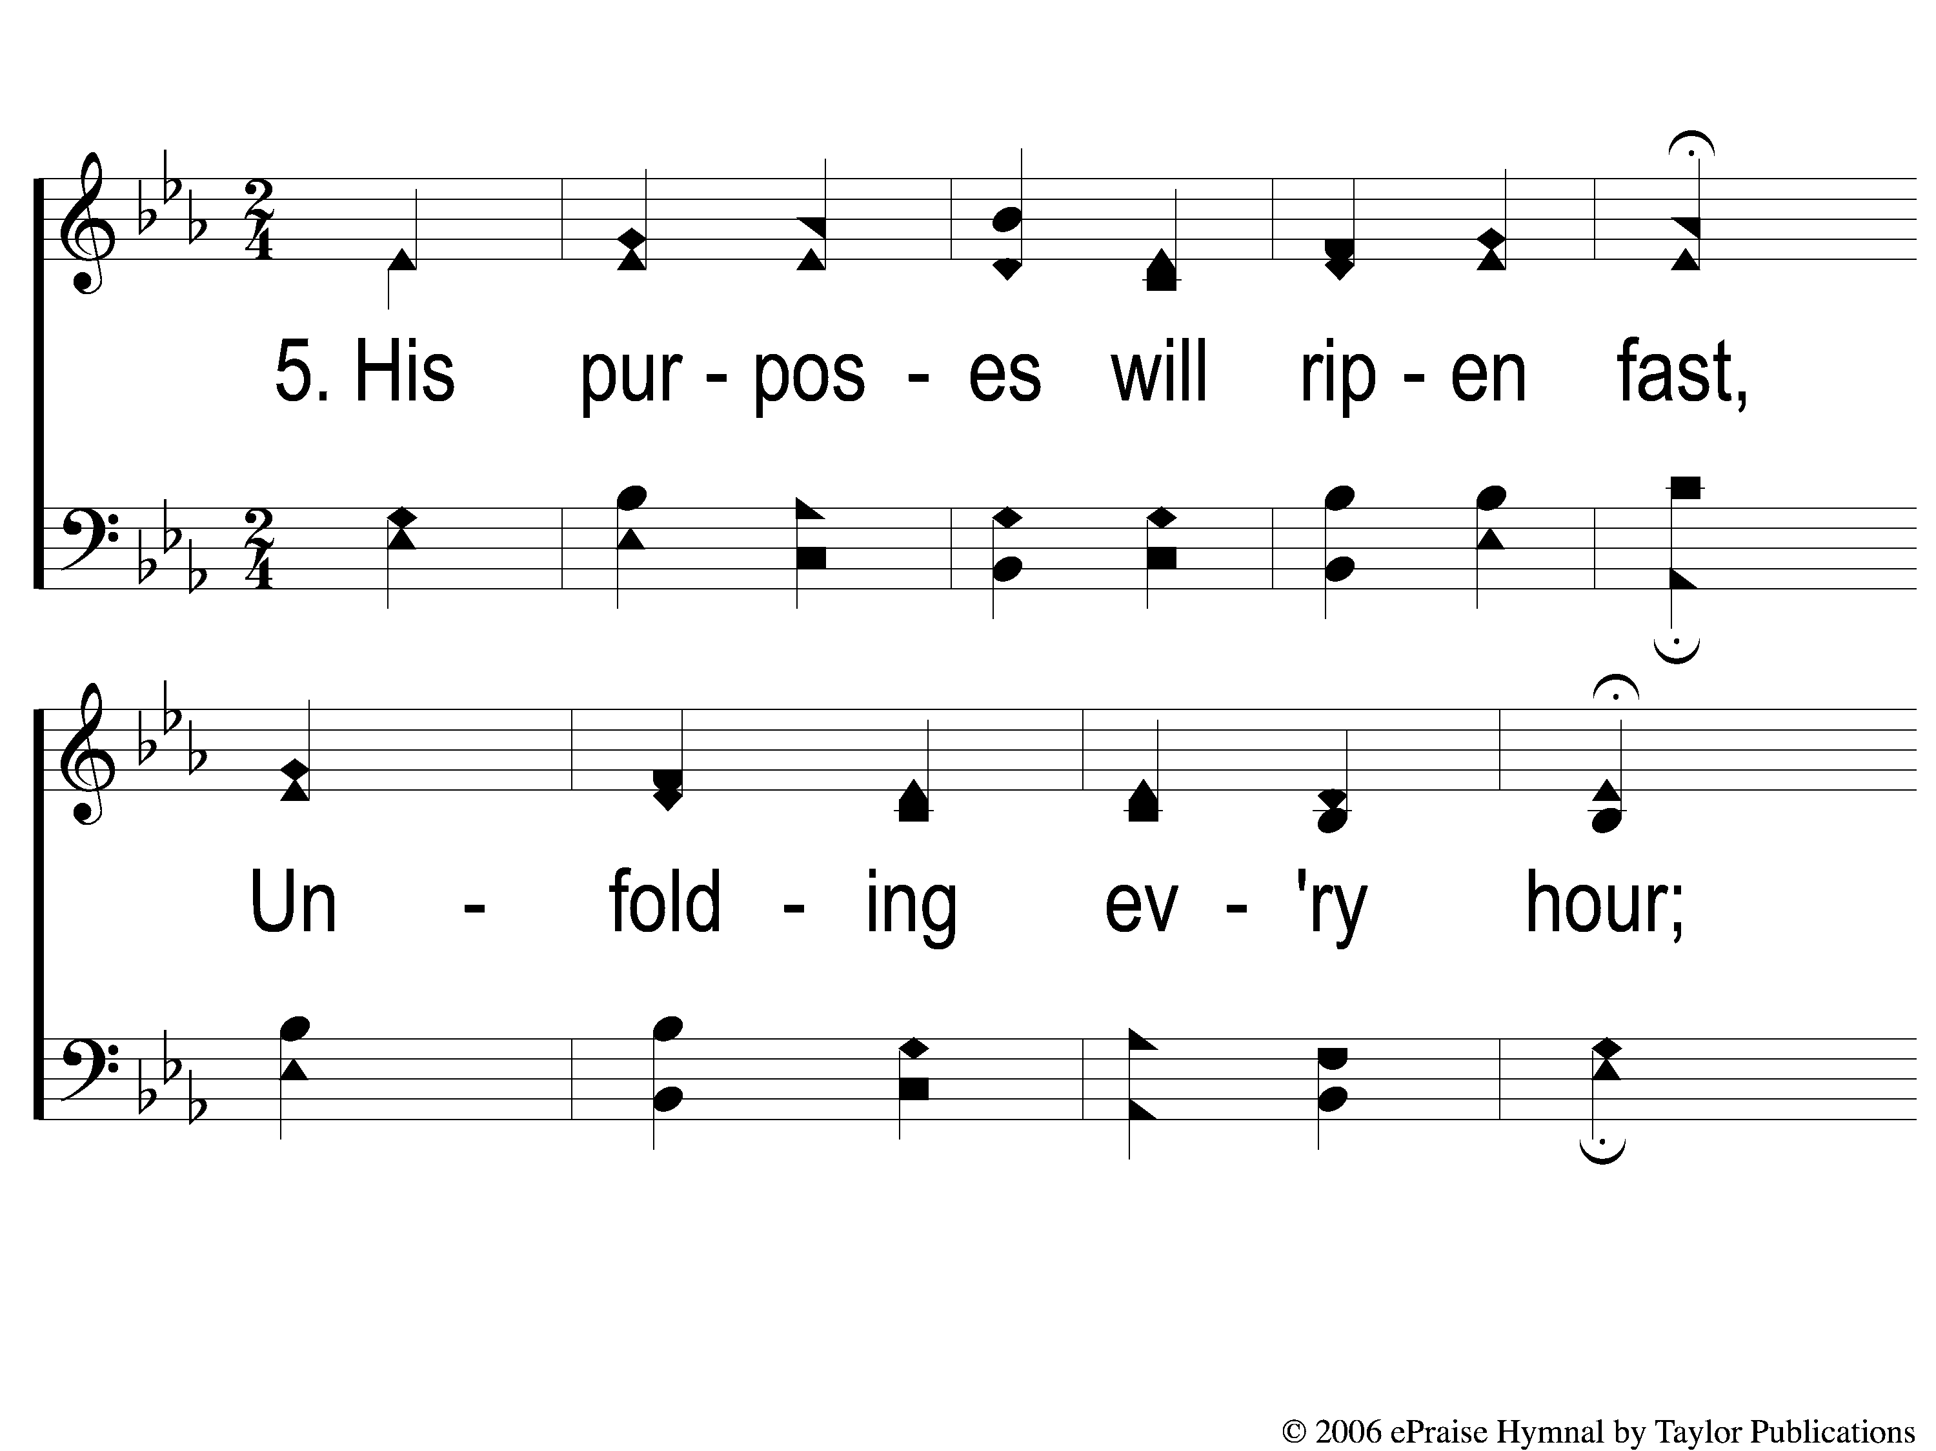
5-1 God Moves in a Mysterious Way
God Moves In A Mysterious Way
135

Slide 10
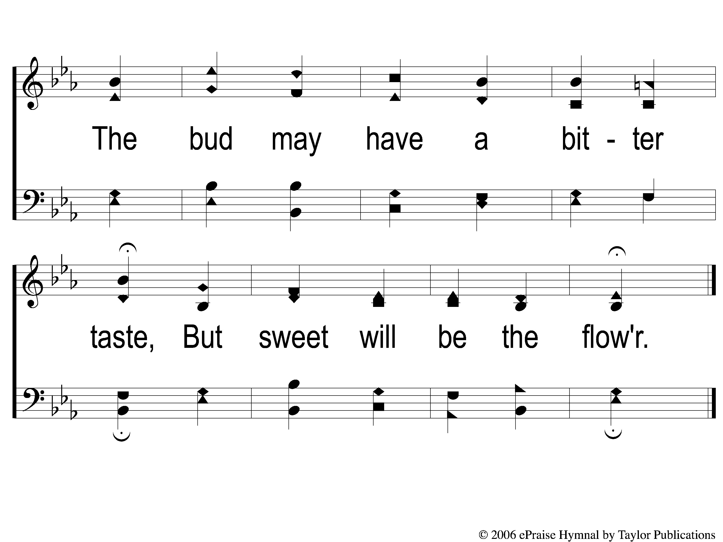
5-2 God Moves in a Mysterious Way
God Moves In A Mysterious Way
135

Slide 11
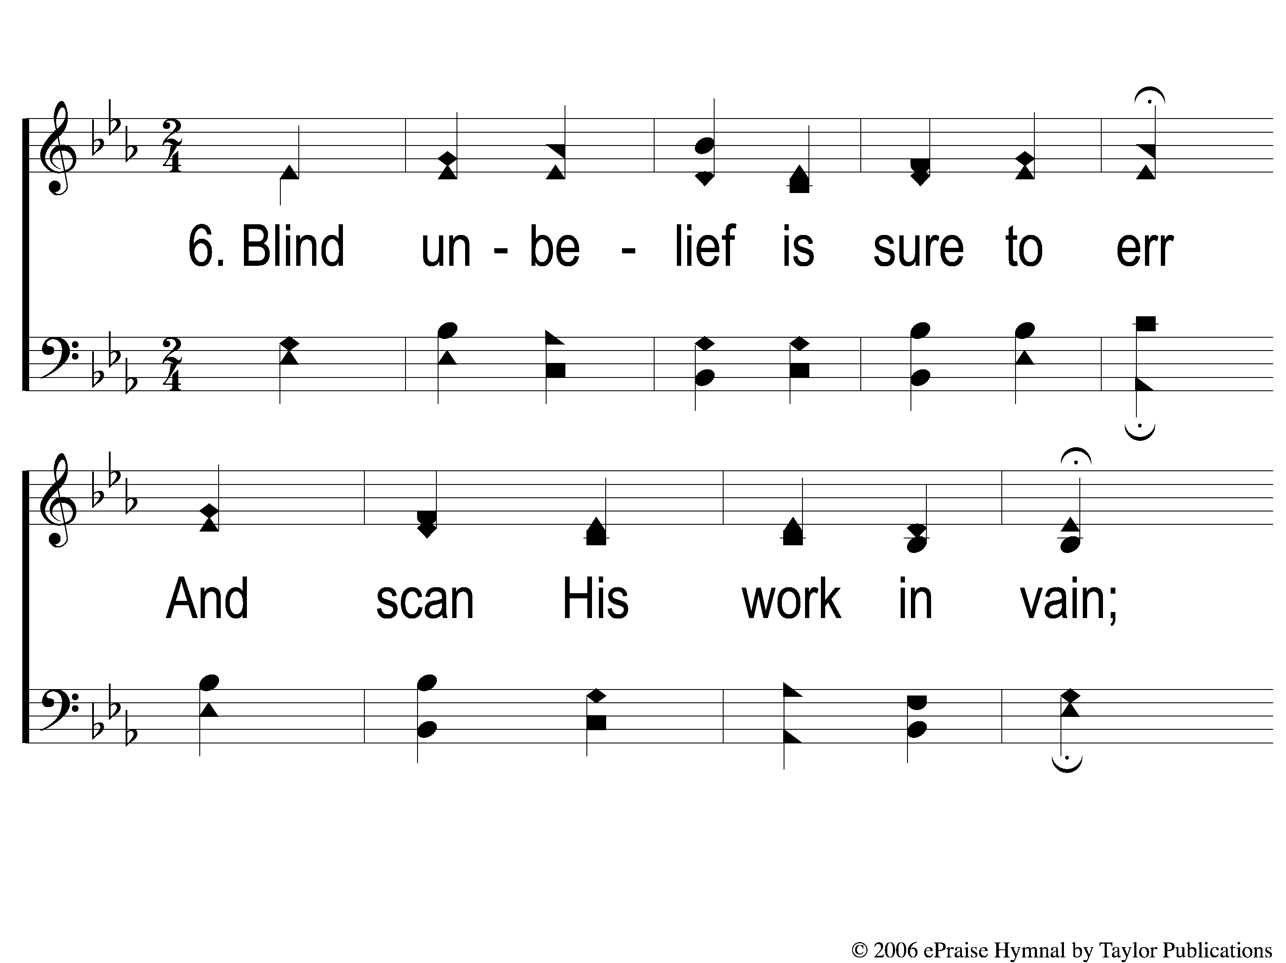
6-1 God Moves in a Mysterious Way
God Moves In A Mysterious Way
135

Slide 12
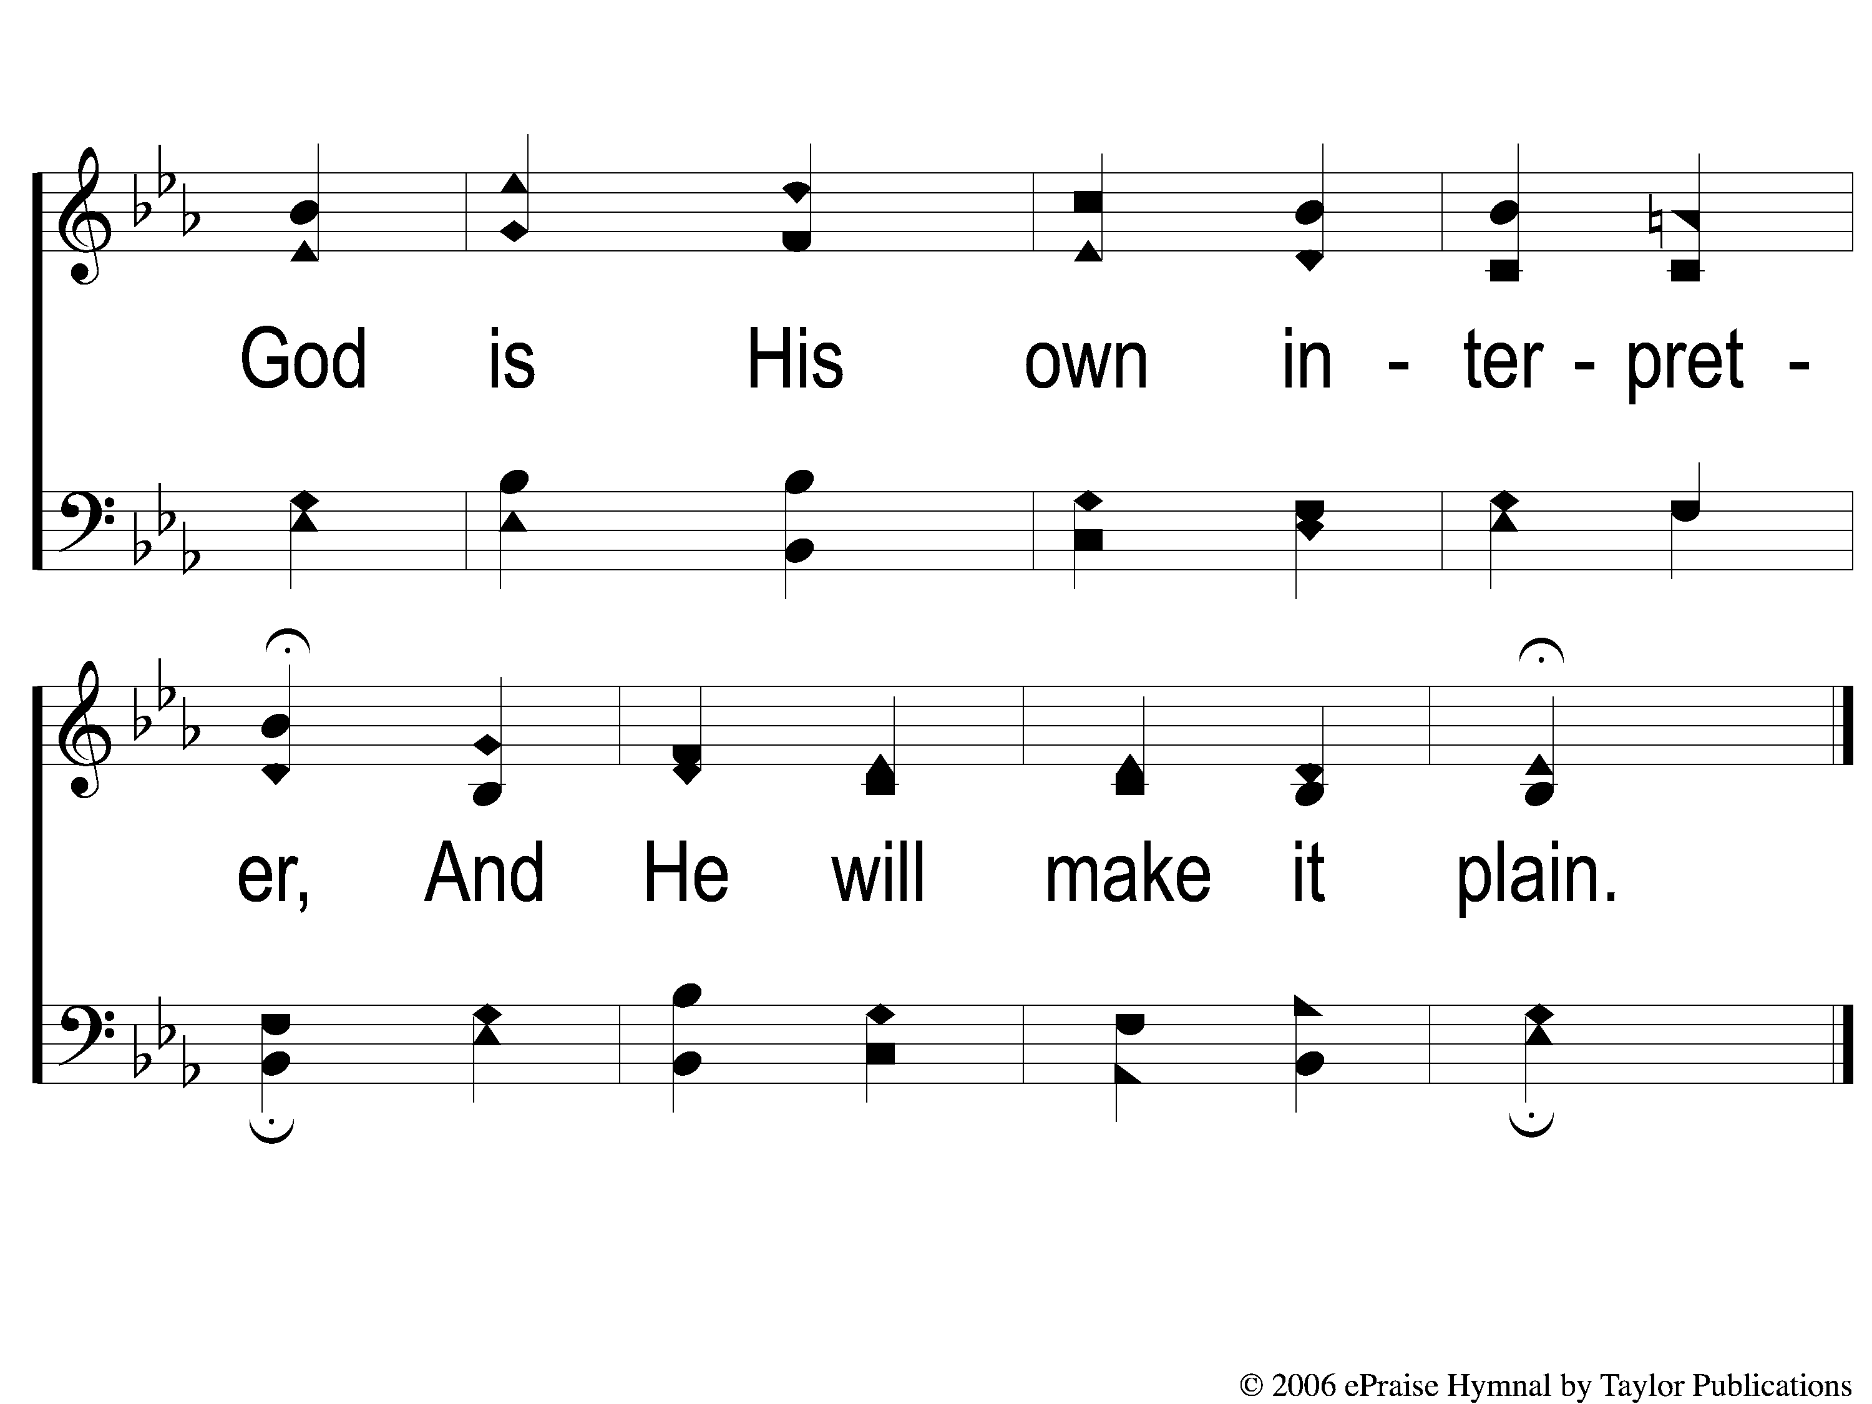
6-2 God Moves in a Mysterious Way
God Moves In A Mysterious Way
135

